Slide 1

My internship: data Engineering & Business intelligence
Karolis Markovas

Slide 2
Agenda
Data Set Overview
What I have done during the internship
Power Bi Dashboard
Q&A
Technical Skills Gained

Slide 3

Data Set Overview
The Data Set I received was about UEFA 2020 soccer matches.
In them, I had 6 different raw data tables in total, they included player and team statistics, matches played and events occurred during the games

Slide 4
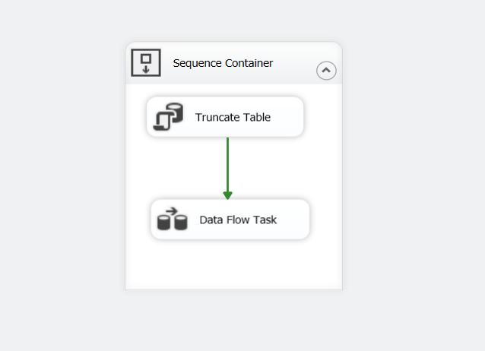
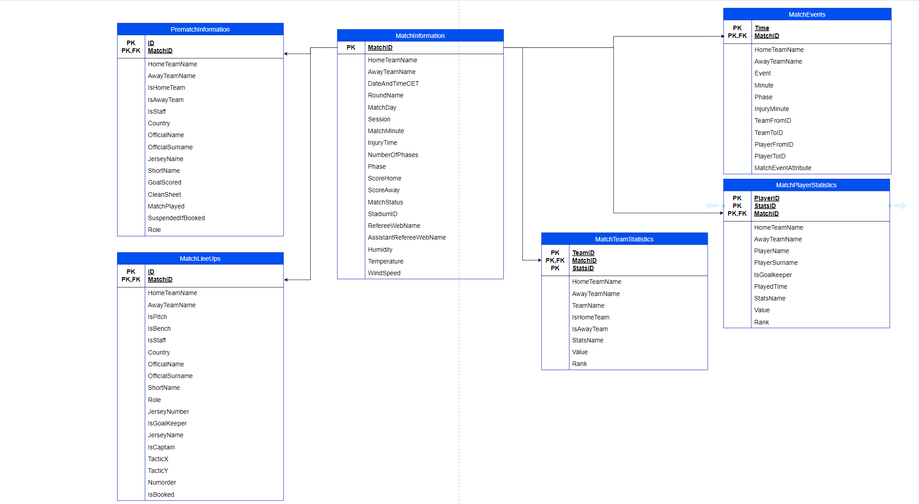
What I have done during the internship
Staging Schema and SSIS procedures:
First step was to investigate the received data and created its schema, on how each table is connecting.
Then I need to create loading procedures in SSIS.

Slide 5
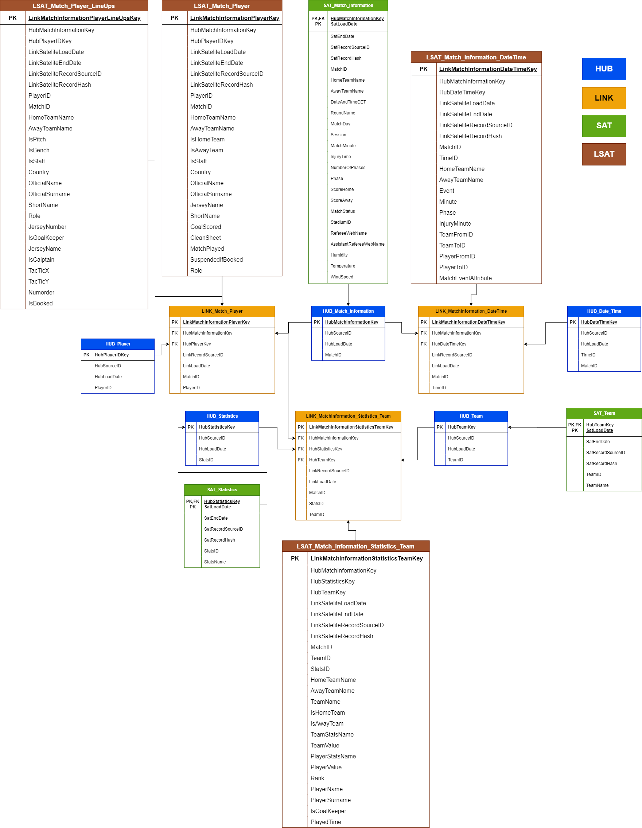
What I have done during the internship
Data Vault 2.0:
First step was to create a schema for the Data Vault.
Second step was to write loading procedures, that generated business keys, extracted data from the Staging tables and loaded it into Data Vault entities.

Slide 6
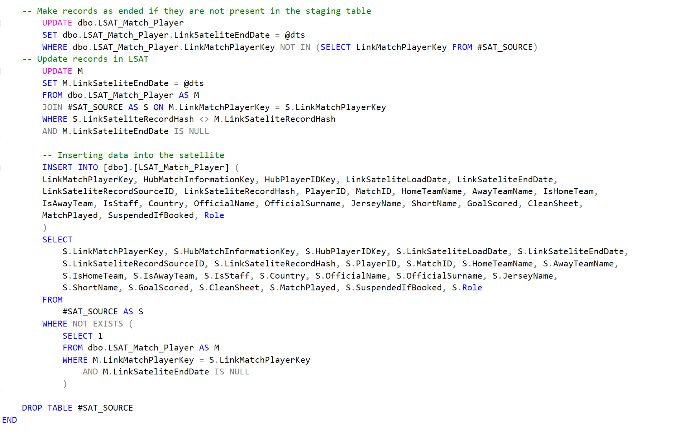
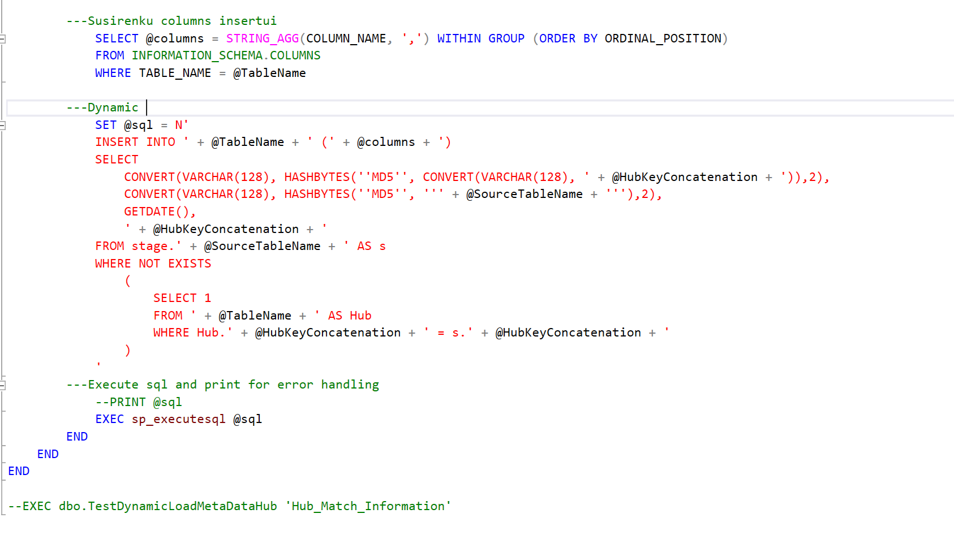
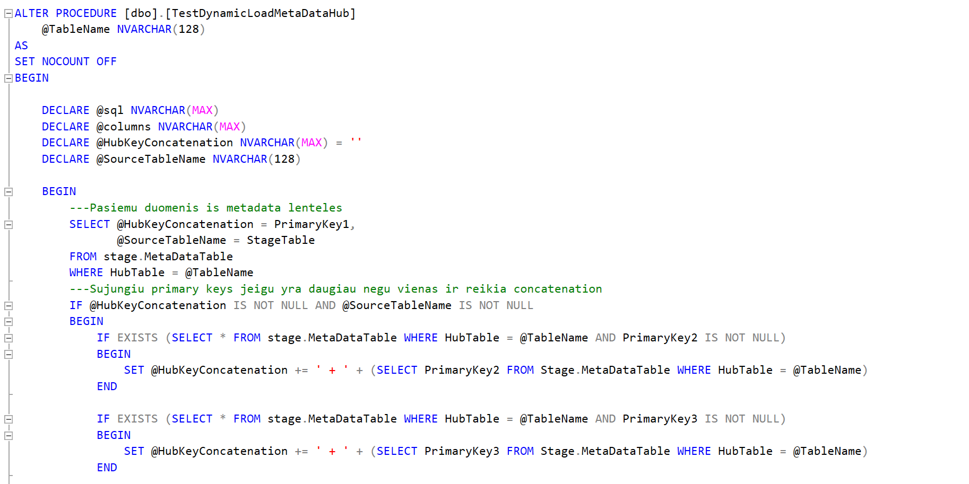
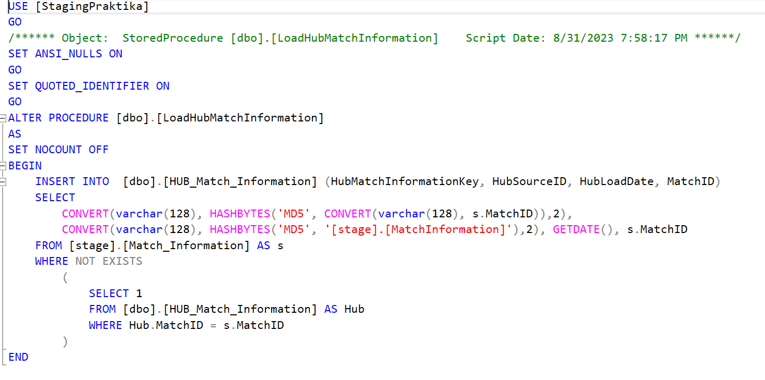
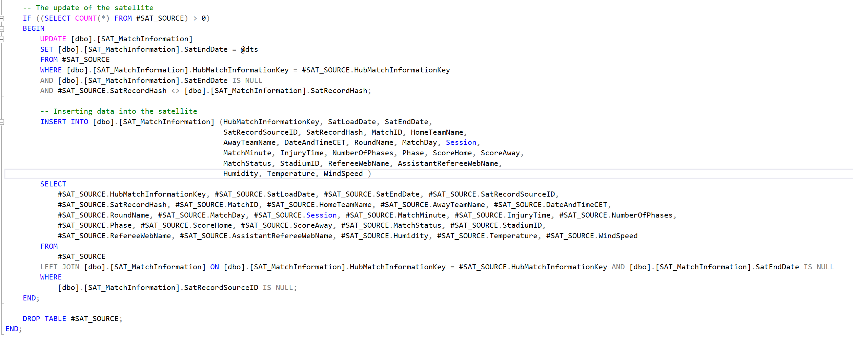
What I have done during the internship

Slide 7
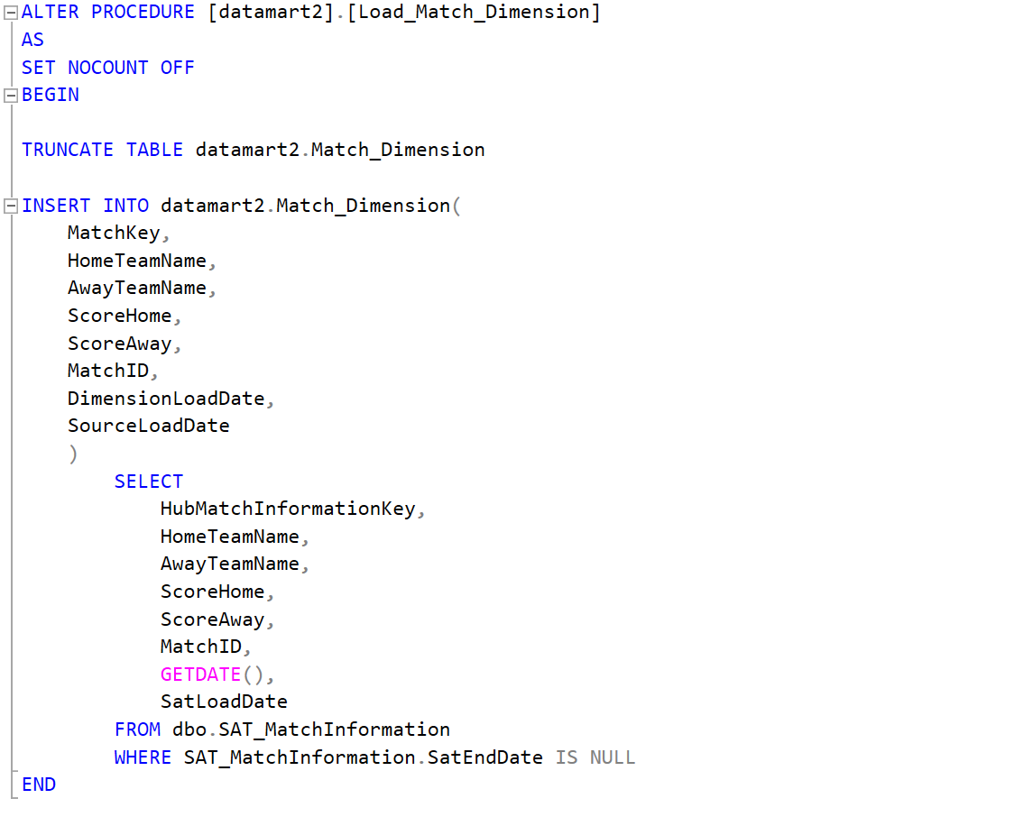
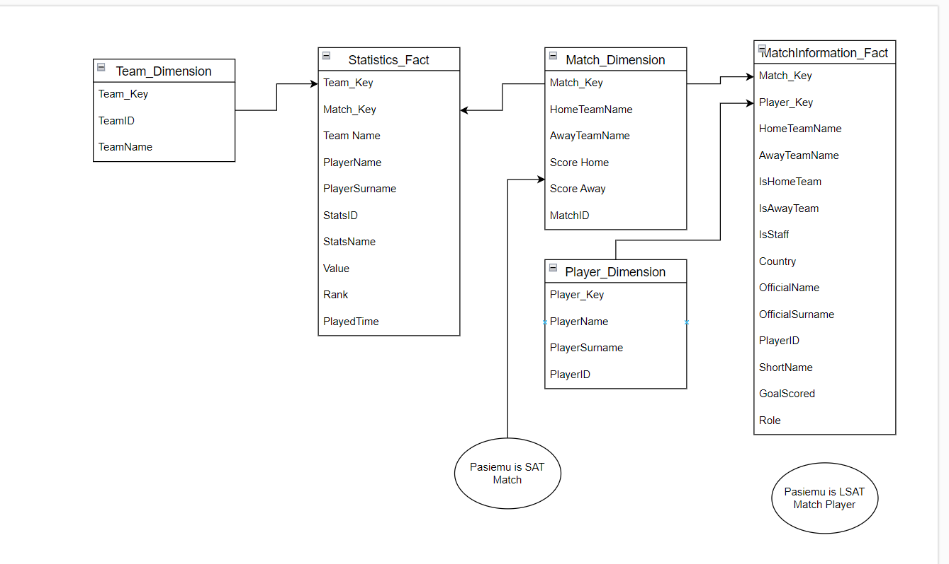
What I have done during the internship
Data Mart:
After creating Data Vault and writing loading procedures, I needed to create Data Mart schema, using Star methodology.
Once schema was completed, simple loading procedures were created.

Slide 8

Power Bi Dashboard

Slide 9
Technical Skills Gained
T-SQL Proficiency: I’ve developed a strong command of Transact-SQL, enabling me to craft complex queries, perform data transformations, and manage data within the database.
Data Vault 2.0 implementation: I successfully implemented Data Vault 2.0, creating hubs, links, and satellites to enhance data warehousing architecture, making it more flexible.
ETL Expertise: I’ve honed my skills in Extract, Transform, Load processes, ensuring seamless data integration, quality assurance and efficient data loading.
Data Loading Strategies: I became proficient in loading data into hubs, links and satellites, ensuring data quality and facilitating easy access for analytics.
Data Mart Development: I’ve created a focused data mart, tailored to my specific data set, promoting more efficient data retrieval and analysis.
Data Visualization with Power BI: I’ve become proficient in Power BI, using it to create visually appealing and informative reports and dashboards.

